Slide 1


Scientific
Computing
START
Ting-Wei
Su
Chien-Hao
Wu
Numerical
Options
Pricing
Wan-Yun
Yang

Slide 2

Numerical
Schemes and
Program
Demonstration
Problem
Formulation and Background Knowledge
OUTLINE
Error Analysis
and Main Results

Slide 3

Chien
建
Hao
W
模
U
所

Slide 4

What Is A Derivative?
A derivative is an instrument whose value depends on the values of other more basic underlying variables.
What Is A Derivative?

Slide 5

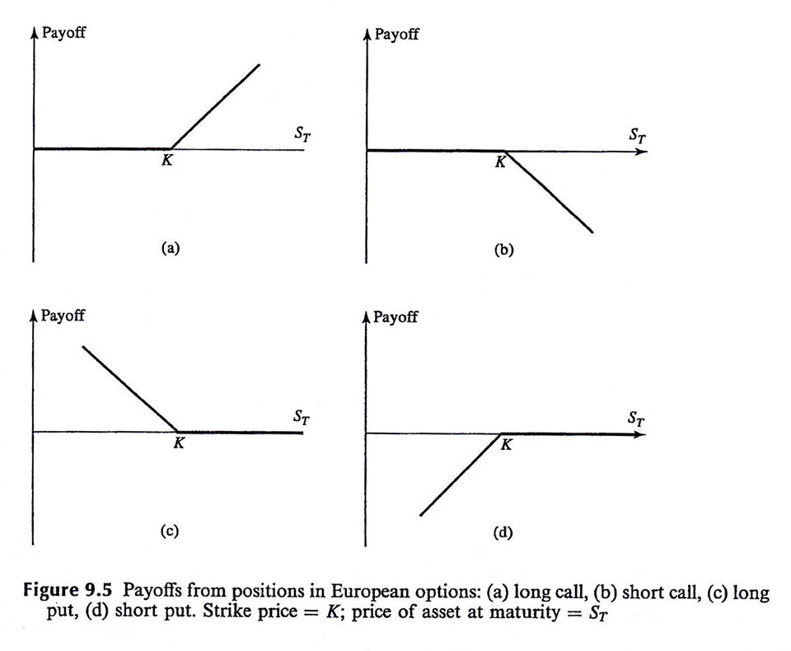
01
Call Option
02
Put Option
Excerpted from John C. Hull, Fundamentals of Futures and Options Markets, 8ed, p.215

Slide 6

European Style
American Style

Slide 7

Determination Of
The Option Price
01
Law of Supply and Demand
gives the Equilibrium Price
02
No Riskless Arbitrage Oppor-
tunities exist in the market
03
Efficient Market Hypothesis (EMH)

Slide 8
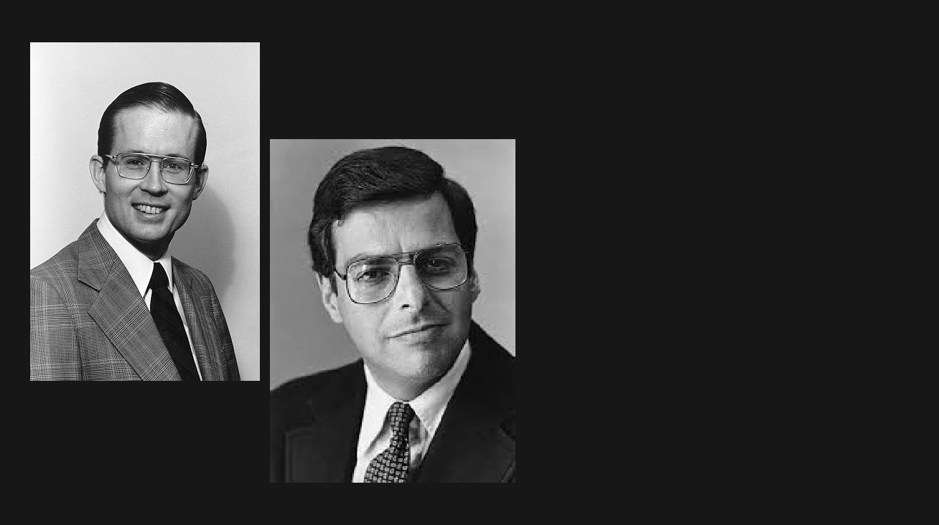
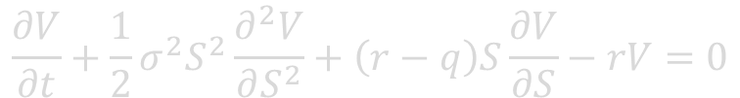
The Black-Scholes Equation
$$\frac{∂V}{∂t}+\frac{1}{2}σ^{2}S^{2}\frac{∂^{2}V}{∂S^{2}}+\left(r−q\right)S\frac{∂V}{∂S}−rV=0$$
V: the value of the option considered
S₀: the current stock price
K: the strike price or the exercise price
T: the maturity time or the expiration time
σ: the value of the option consider
Fischer Black (1938-1995)
r: the risk-free interest rate
q: the expected dividend yield
We seek to solve V(S, t; S₀, K, T, σ, r, q) under some boundary conditions.
Myron Scholes (1941-)

Slide 9

DIMENSIONAL ANALYSIS

Slide 10
OUTLINE
Numerical
Schemes and
Program
Demonstration
Numerical
Schemes and
Program
Demonstration
Problem
Formulation and Background Knowledge
Error Analysis
and Main Results

Slide 11

DIFFERENT
METHODS
Heat-Equation
Approach
Direct FTCS
Method
Direct Crank-
Nicolson Method

Slide 12

建
Ting
S
Wei
U
模
所

Slide 13


Motivation
It's a one-dimensional heat equation in disguise.
It's a backward diffusion equation
Boundary
Conditions
Change of
Variables
Heat-Equation Approach
The present can only be solved from the future.
Demonstration

Slide 14


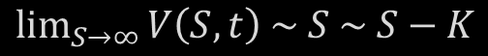




$$V\left(0,t\right)=0, \lim_{S→∞}{V\left(S,t\right) \sim S}$$
CALL
$$V\left(S,T\right)=\max_{ }{(S−K, 0)}$$
PUT
$$V\left(0,t\right)=Ke^{−r(T−t)}, \lim_{S→∞}{V\left(S,t\right) \sim 0}$$
CALL
$$\lim_{S→∞}{V\left(S,t\right) \sim S \sim S−Ke^{−r(T−t)}}$$
$$V\left(S,T\right)=\max_{ }{(K−S, 0)}$$
European Style
How to Truncate the Conditions ?
American Style
$$V\left(0,t\right)=0, \lim_{S→∞}{V\left(S,t\right) \sim S}$$
CALL
$$\lim_{S→∞}{V\left(S,t\right) \sim S \sim S−K}$$
CALL
$$V\left(S,T\right)=\max_{ }{(S−K, 0)}$$
PUT
$$V\left(0,t\right)=K, \lim_{S→∞}{V\left(S,t\right) \sim 0}$$
$$V\left(S,T\right)=\max_{ }{(K−S, 0)}$$

Slide 15

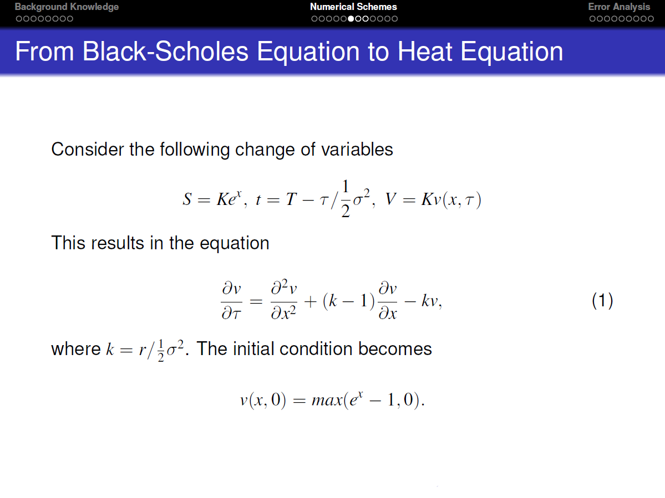

Slide 16

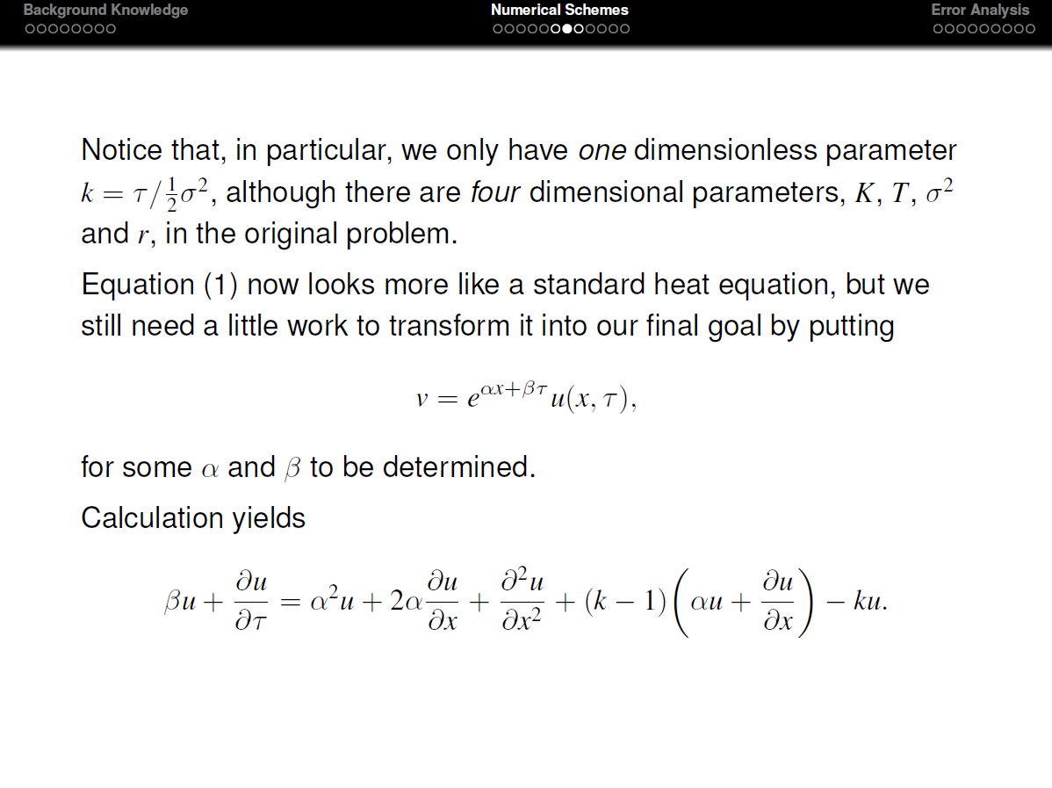
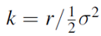

Slide 17
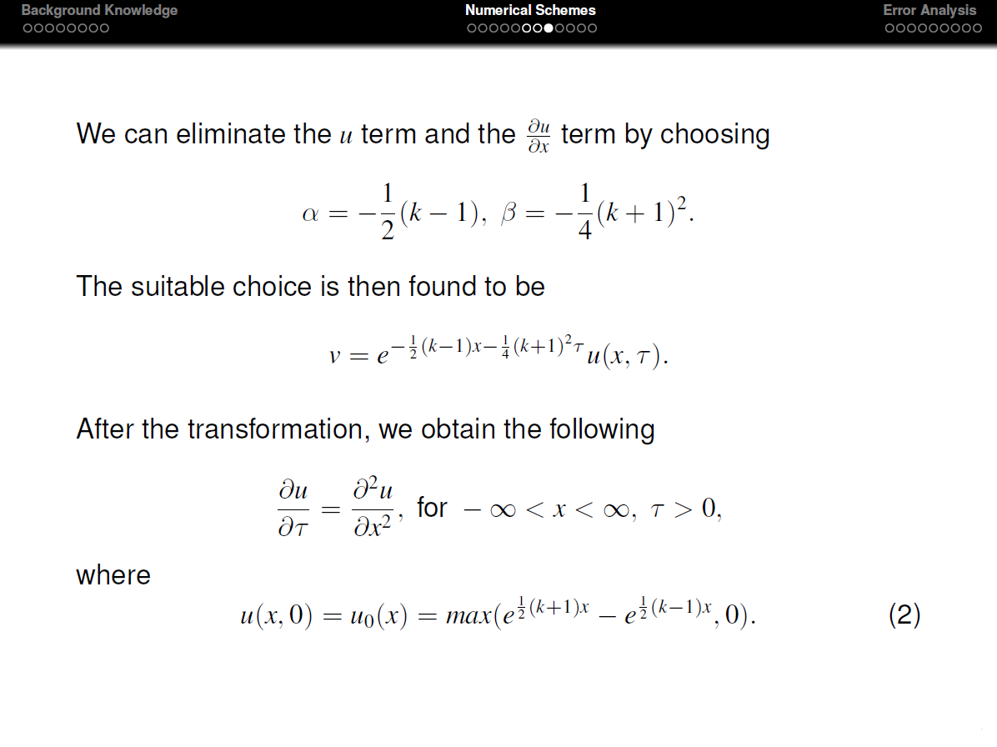

Slide 18

DEMO TIME

Slide 19

Wan
應
Yun
Y
A
數
N
G
系

Slide 20
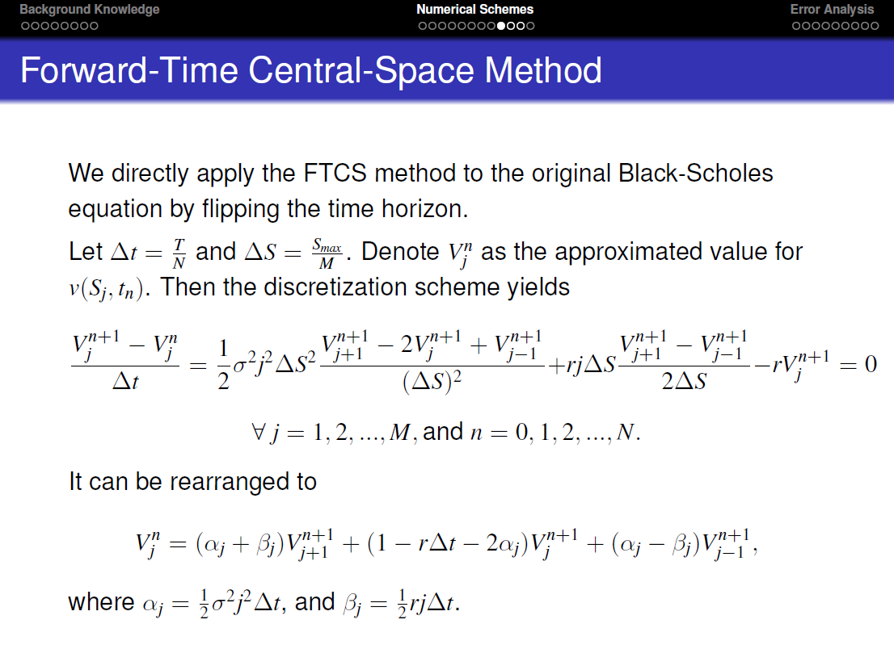

Slide 21

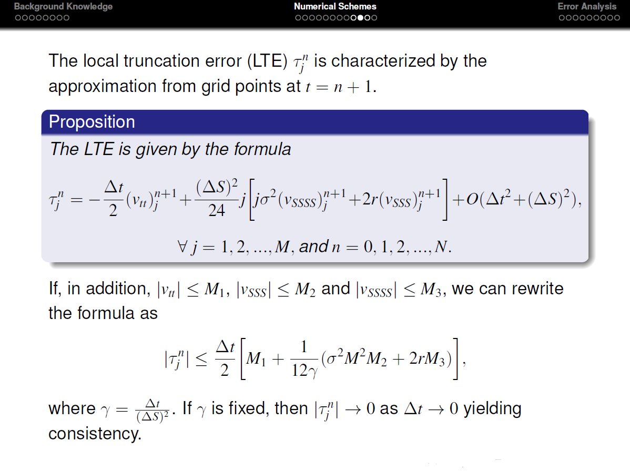

Slide 22

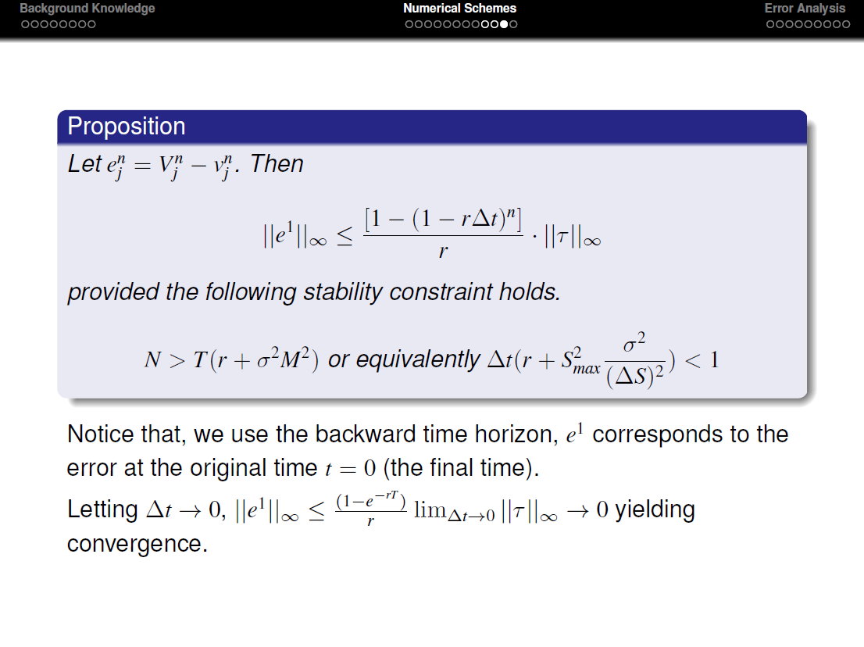

Slide 23
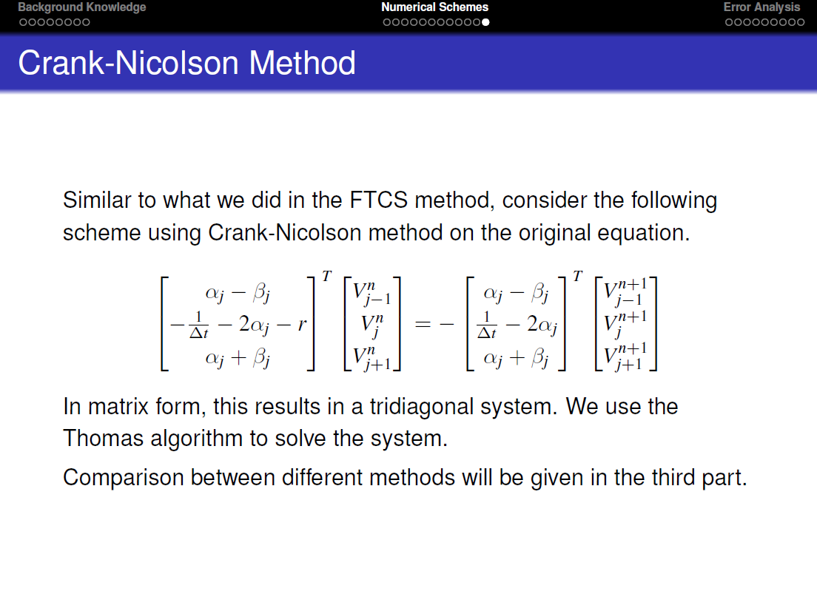

Slide 24

THOMAS ALGORITHM
Used To Solve Tridiagonal
Systems Of Equations

Slide 25
OUTLINE
Numerical
Schemes and
Program
Demonstration
Numerical
Schemes and
Program
Demonstration
Problem
Formulation and Background Knowledge
Error Analysis
and Main Results

Slide 26
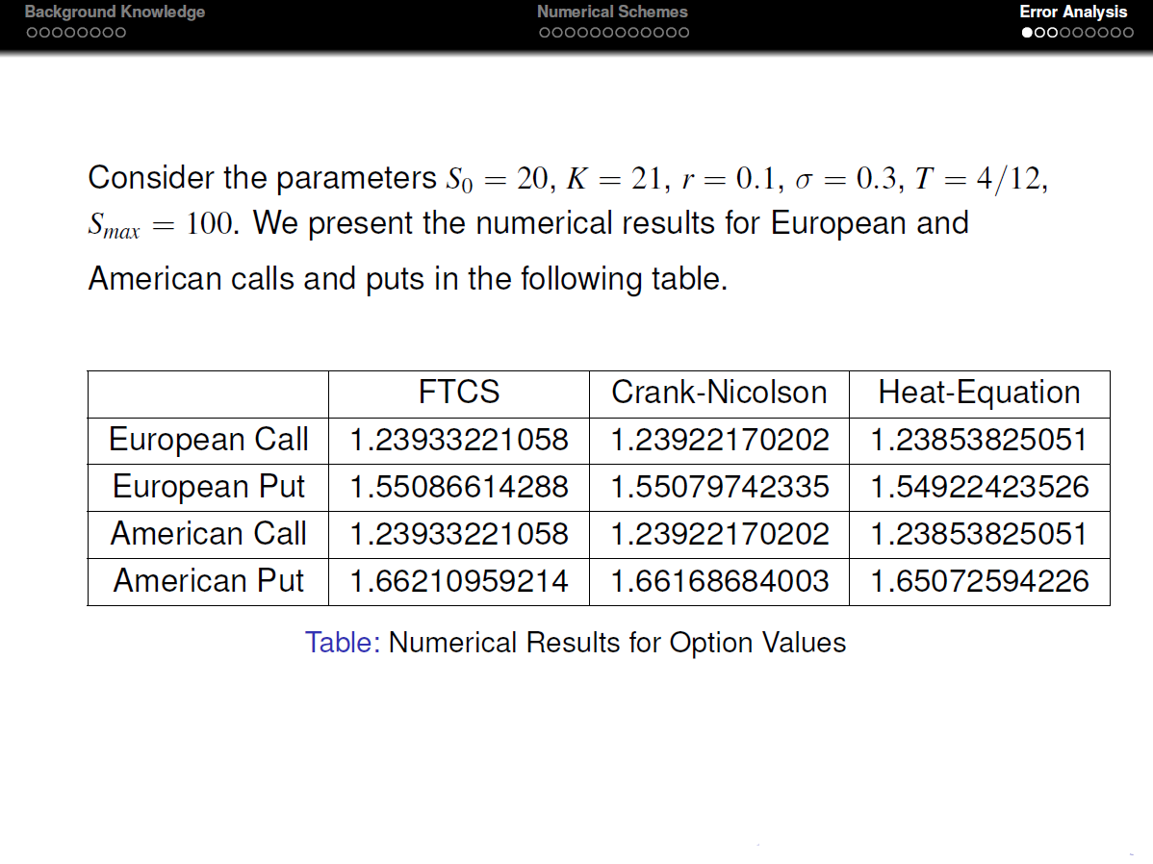

Slide 27
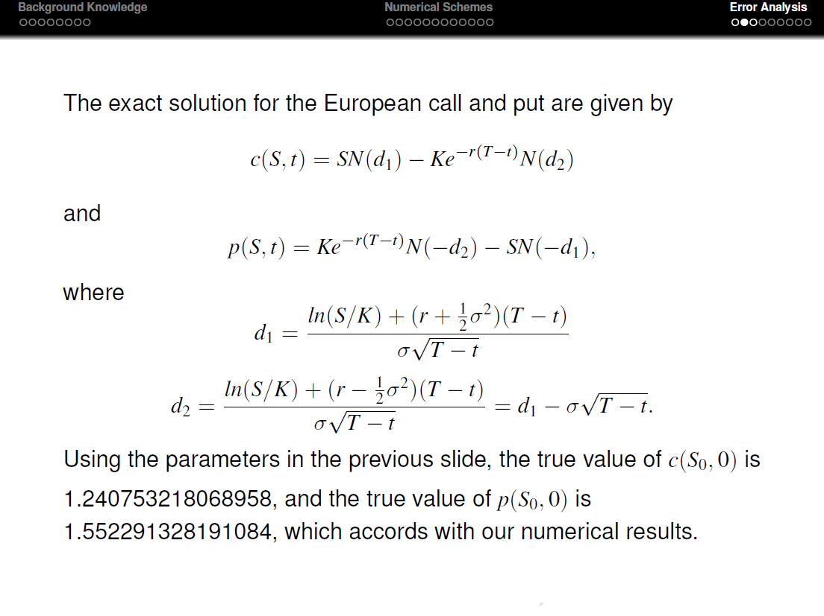

Slide 28
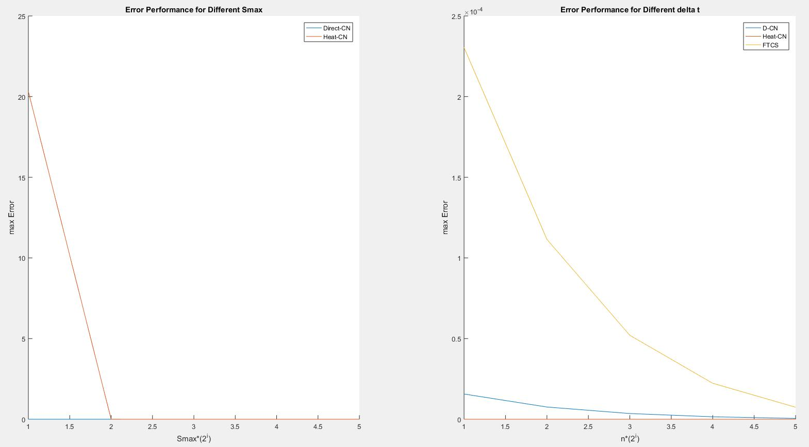
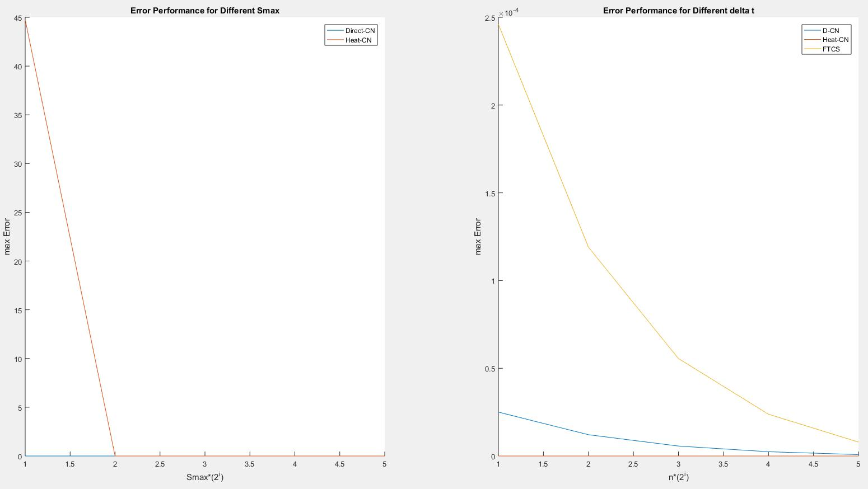
Put
European
Call

Slide 29
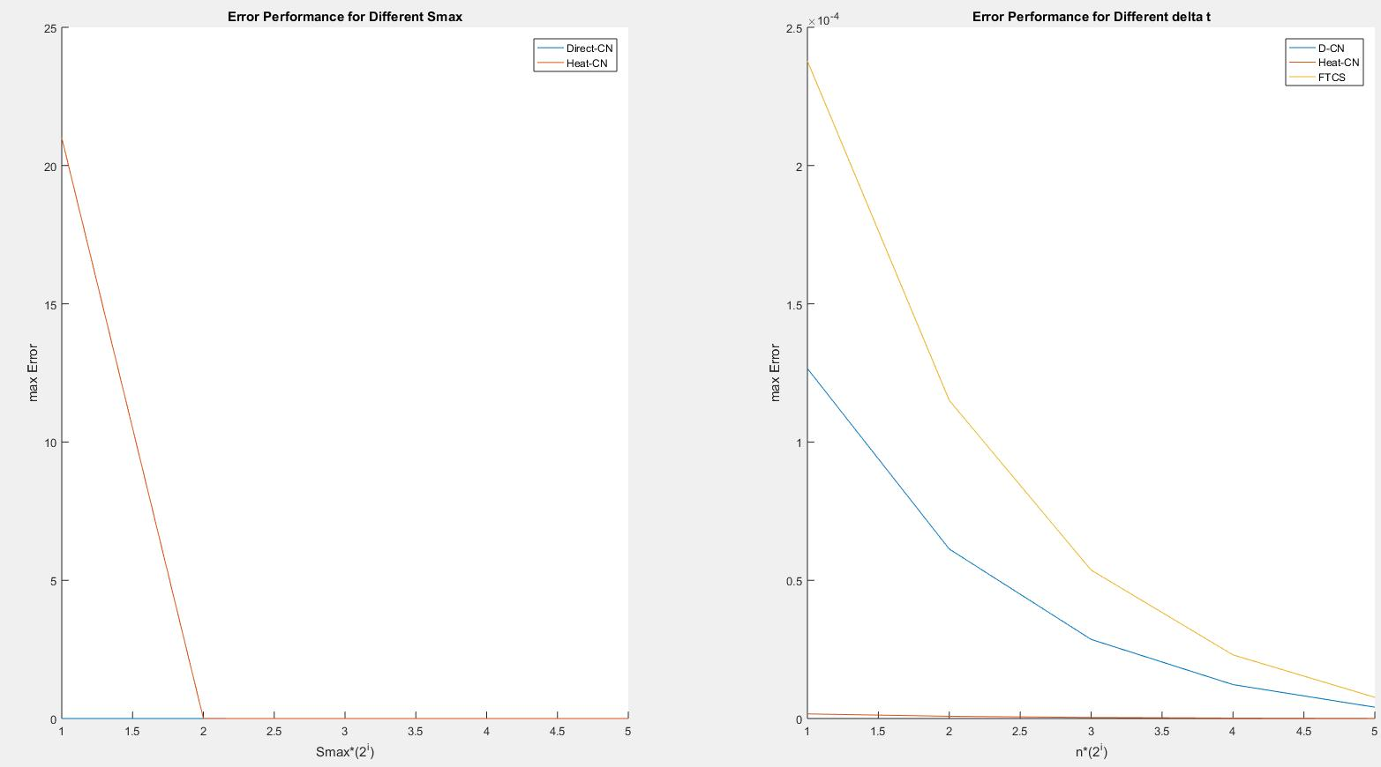
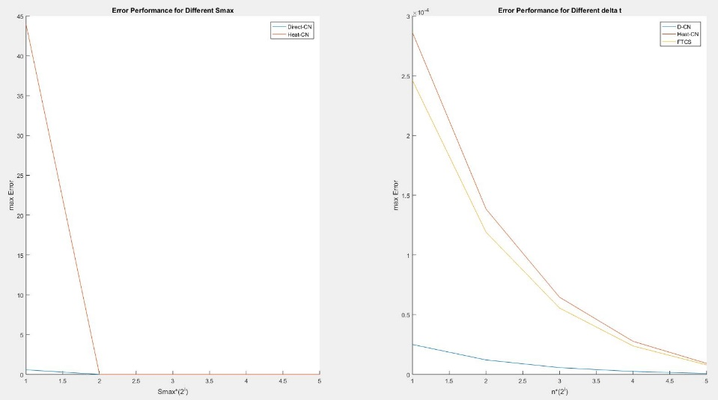
American
Put
Call

Slide 30

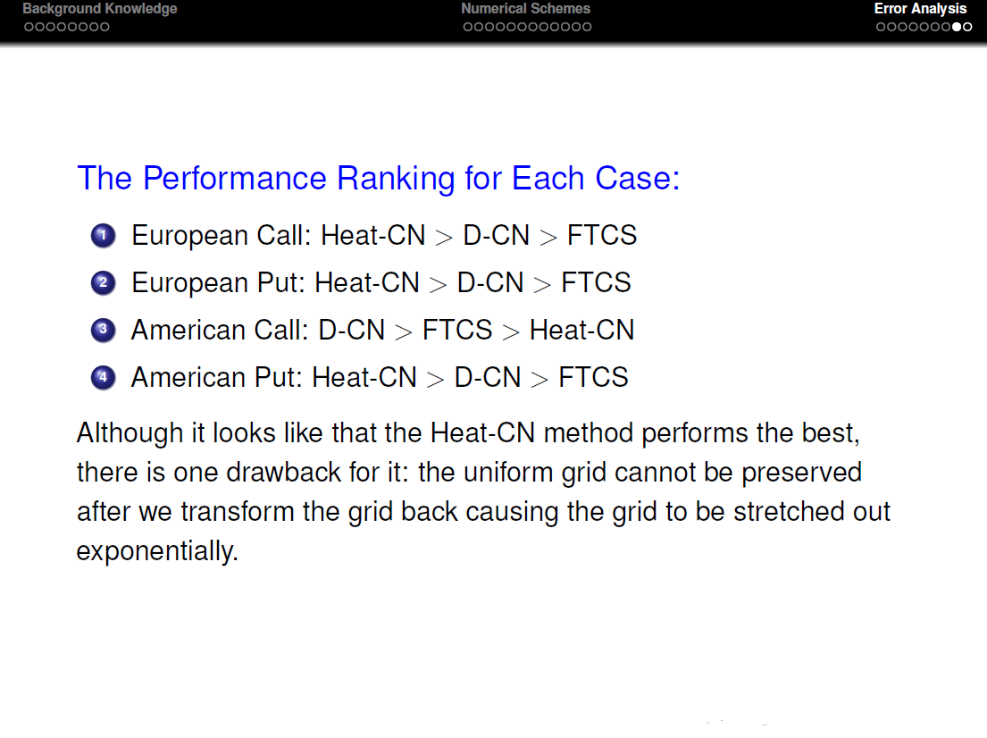

Slide 31
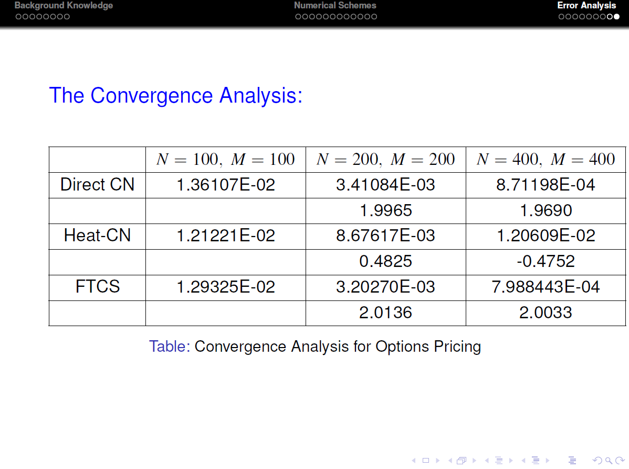

Slide 32

Thanks For
Listening

